Slide 1
Operations Management
By Tanmoy Das
Industrial Engineer
Certified Six Sigma Green Belt from ASQ

Slide 2
Work Study

Slide 3
Outline of Work Study
A. Methods analysis (e.g., charting, workstation design, motion economy) B. Time study (e.g., time standards, allowances) C. Predetermined time standard systems (e.g., MOST, MTM) D. Work sampling E. Learning curves

Slide 4
Work study
Work study may be defined as the analysis of a job for the purpose of finding the preferred method of doing it and also determining the standard time to perform it by the preferred (or given) method. Work study, therefore, comprises of two areas of study: method study (motion study) and time study (work measurement).
Work Study
Method Study
Work Measurement
Stop watch time study
Work Sampling
Predetermined Data

Slide 5
A. Methods analysis (e.g., charting)

Slide 6
A. Methods analysis (e.g. workstation design)

Slide 7
A. Methods analysis (e.g. motion economy)
motion study: Systematic study of the human motions used to perform an operation.

Slide 8
B. Time study (e.g., time standards, allowances)
Work measurement: determining how long it ought to take to perform a job
A standard time is the amount of time it should take a qualified worker to complete a specified task, working at a sustainable rate, using given methods, tools and equipment, raw material inputs, and workplace arrangement
The basic steps in a time study are: 1. Define the task to be studied, and inform the worker who will be studied. 2. Determine the number of cycles to observe. 3. Time the job, and rate the worker's performance. 4. Compute the standard time

Slide 9
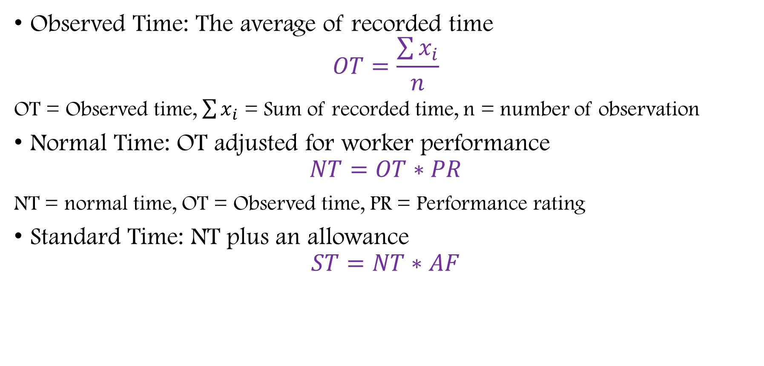
B. Time study (e.g., time standards, allowances)
Observed Time: The average of recorded time
$$OT=\frac{\sum{x_{i}}}{n}$$
OT = Observed time, $\sum{x_{i}}$ = Sum of recorded time, n = number of observation
Normal Time: OT adjusted for worker performance
$$NT=OT∗PR$$
NT = normal time, OT = Observed time, PR = Performance rating
Standard Time: NT plus an allowance
$$ST=NT∗AF$$
Notes:
ONS3.10
3.05
3.10
3.08
3.12
3.15
3.12
3.08
3.05
3.10
3.10
3.05
3.10
3.08
3.12
3.15
3.12
3.08
3.05
3.10

Slide 10
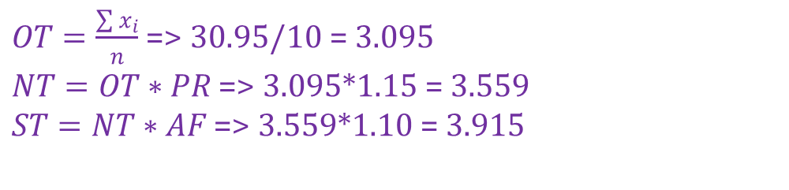
B. Time study (e.g., time standards, allowances)
An industrial engineer conducted a time study of an assembly operation with the times given. The engineer gave a performance rating of 115. The allowance factor is 10% of job time. The standard time for this operation is most nearly: A. 2.96 B. 3.20 C. 3.56 D. 3.92
Observation | Time
1 | 3.10
2 | 3.05
3 | 3.10
4 | 3.08
5 | 3.12
6 | 3.15
7 | 3.12
8 | 3.08
9 | 3.05
10 | 3.10
$OT=\frac{\sum{x_{i}}}{n}$ => 30.95/10 = 3.095
$NT=OT∗PR$ => 3.095*1.15 = 3.559
$ST=NT∗AF$ => 3.559*1.10 = 3.915

Slide 11
C. Predetermined time standard systems (e.g., MOST, MTM)

Slide 12
D. Work sampling

Slide 13
E. Learning curves

